Slide 1
Chapter 10: Safety
Giles: Well, for god’s sake, be careful. . . . If you should be hurt or killed, shall take it amiss. Willow: Well, we try not to get killed. That’s part of our whole mission statement: Don’t get killed. Giles: Good. —Buffy the Vampire Slayer, Season 3

Slide 2
Chapter Outline
What is Safety?
Safety General Scenario
Tactics for Safety
Tactics-Based Questionnaire for Safety
Patterns for Safety
Summary

Slide 3
What is Safety?
“Don’t kill anyone” should be a part of every software architect’s mission statement.
Safety is concerned with a system’s ability to avoid straying into states that lead to damage, injury, or loss of life. These unsafe states can be caused by a variety of factors:
Omissions
Commission
Timing
Problems with system values
Sequence omission and commission
Out of sequence
Safety is concerned with detecting and recovering from these unsafe states to prevent or minimize harm.

Slide 4
What is Safety?
The unsafe state should be recognized and the system should be made safe through
Continuing operations
Shutting down (fail safe), or
Transitioning to a state requiring manual operation
In addition, the unsafe state should be reported and/or logged.
Architecting for safety begins by identifying safety-critical functions using techniques such as failure mode and effects analysis (FMEA; also called hazard analysis) and fault tree analysis (FTA).

Slide 5
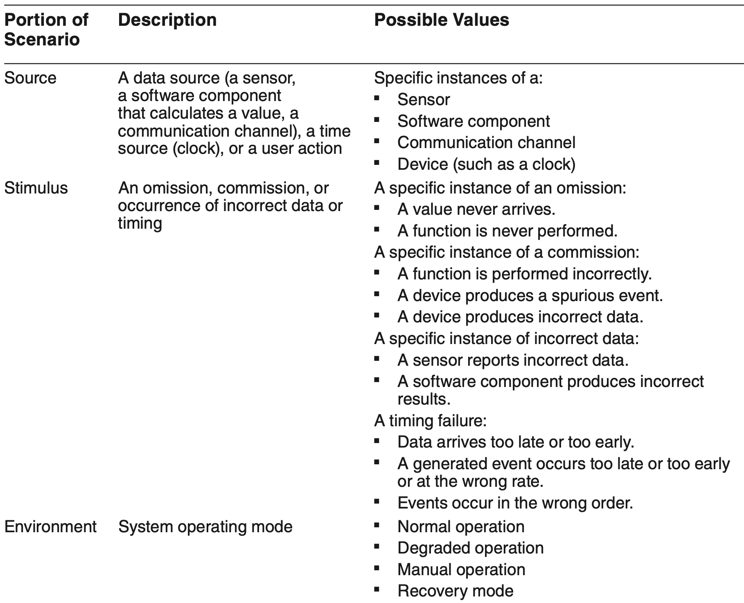
Safety General Scenario

Slide 6
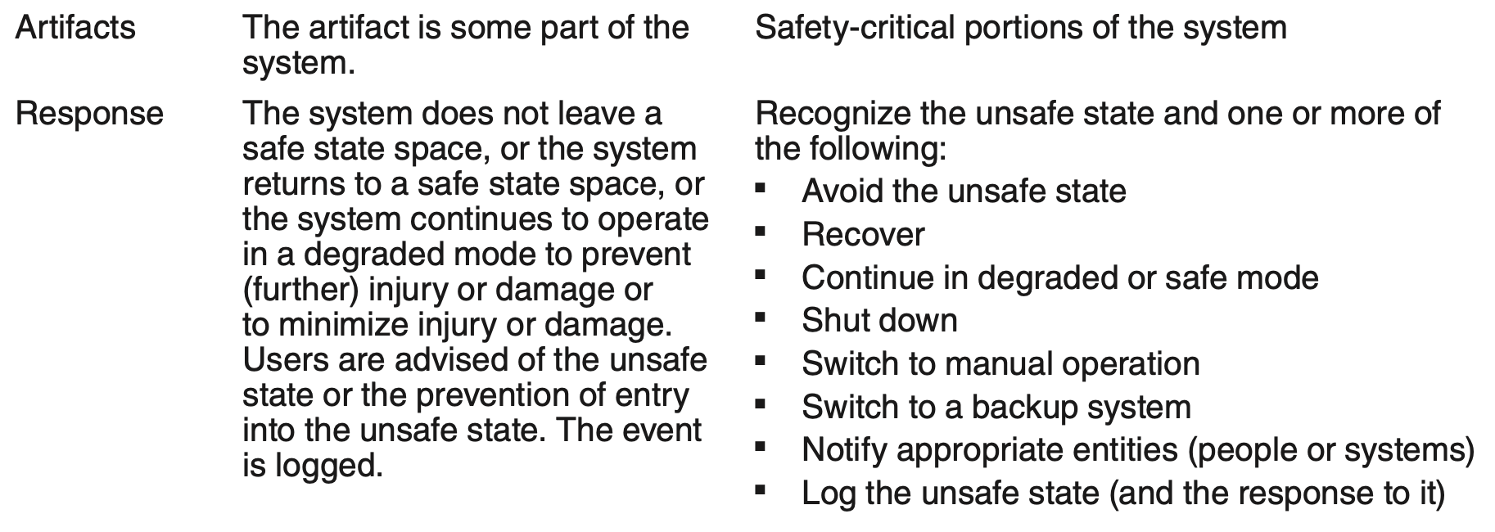
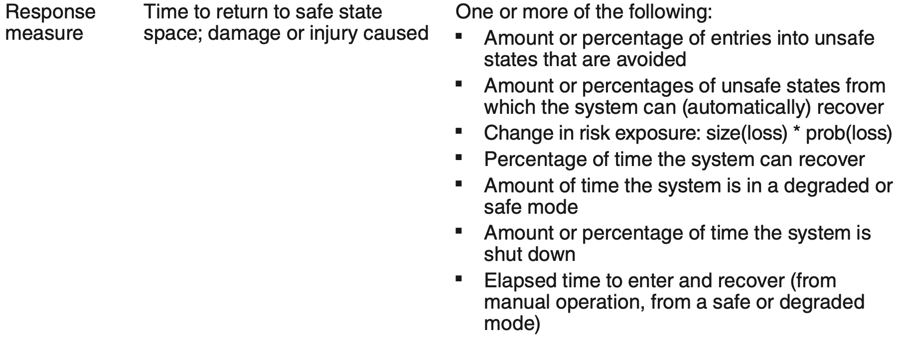
Safety General Scenario

Slide 7
Sample Concrete Safety Scenario
A sensor in the patient monitoring system fails to report a life-critical value after 100 ms. The failure is logged, a warning light is illuminated on the console, and a backup (lower-fidelity) sensor is engaged. The system monitors the patient using the backup sensor after no more than 300 ms.

Slide 8
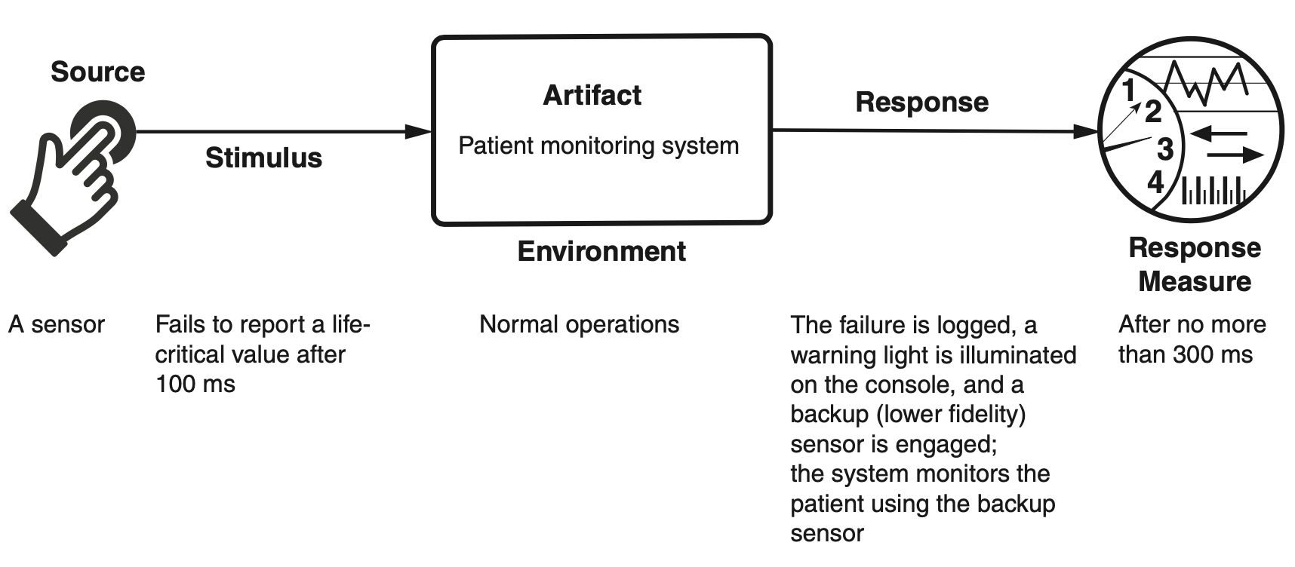
Sample Concrete Safety Scenario

Slide 9
Goal of Safety Tactics
Safety tactics may be broadly categorized as unsafe state avoidance, unsafe state detection, or unsafe state remediation.

Slide 10
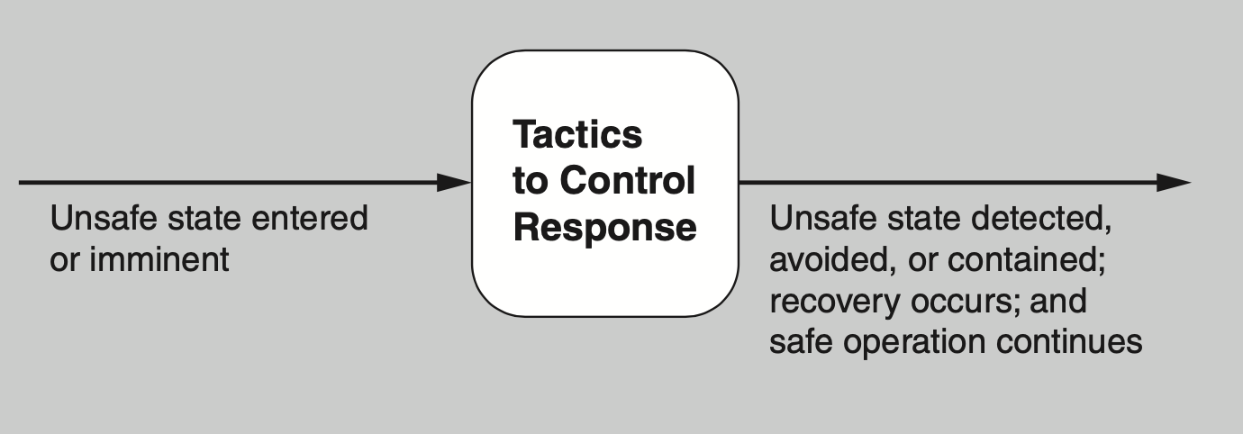
Goal of Safety Tactics

Slide 11
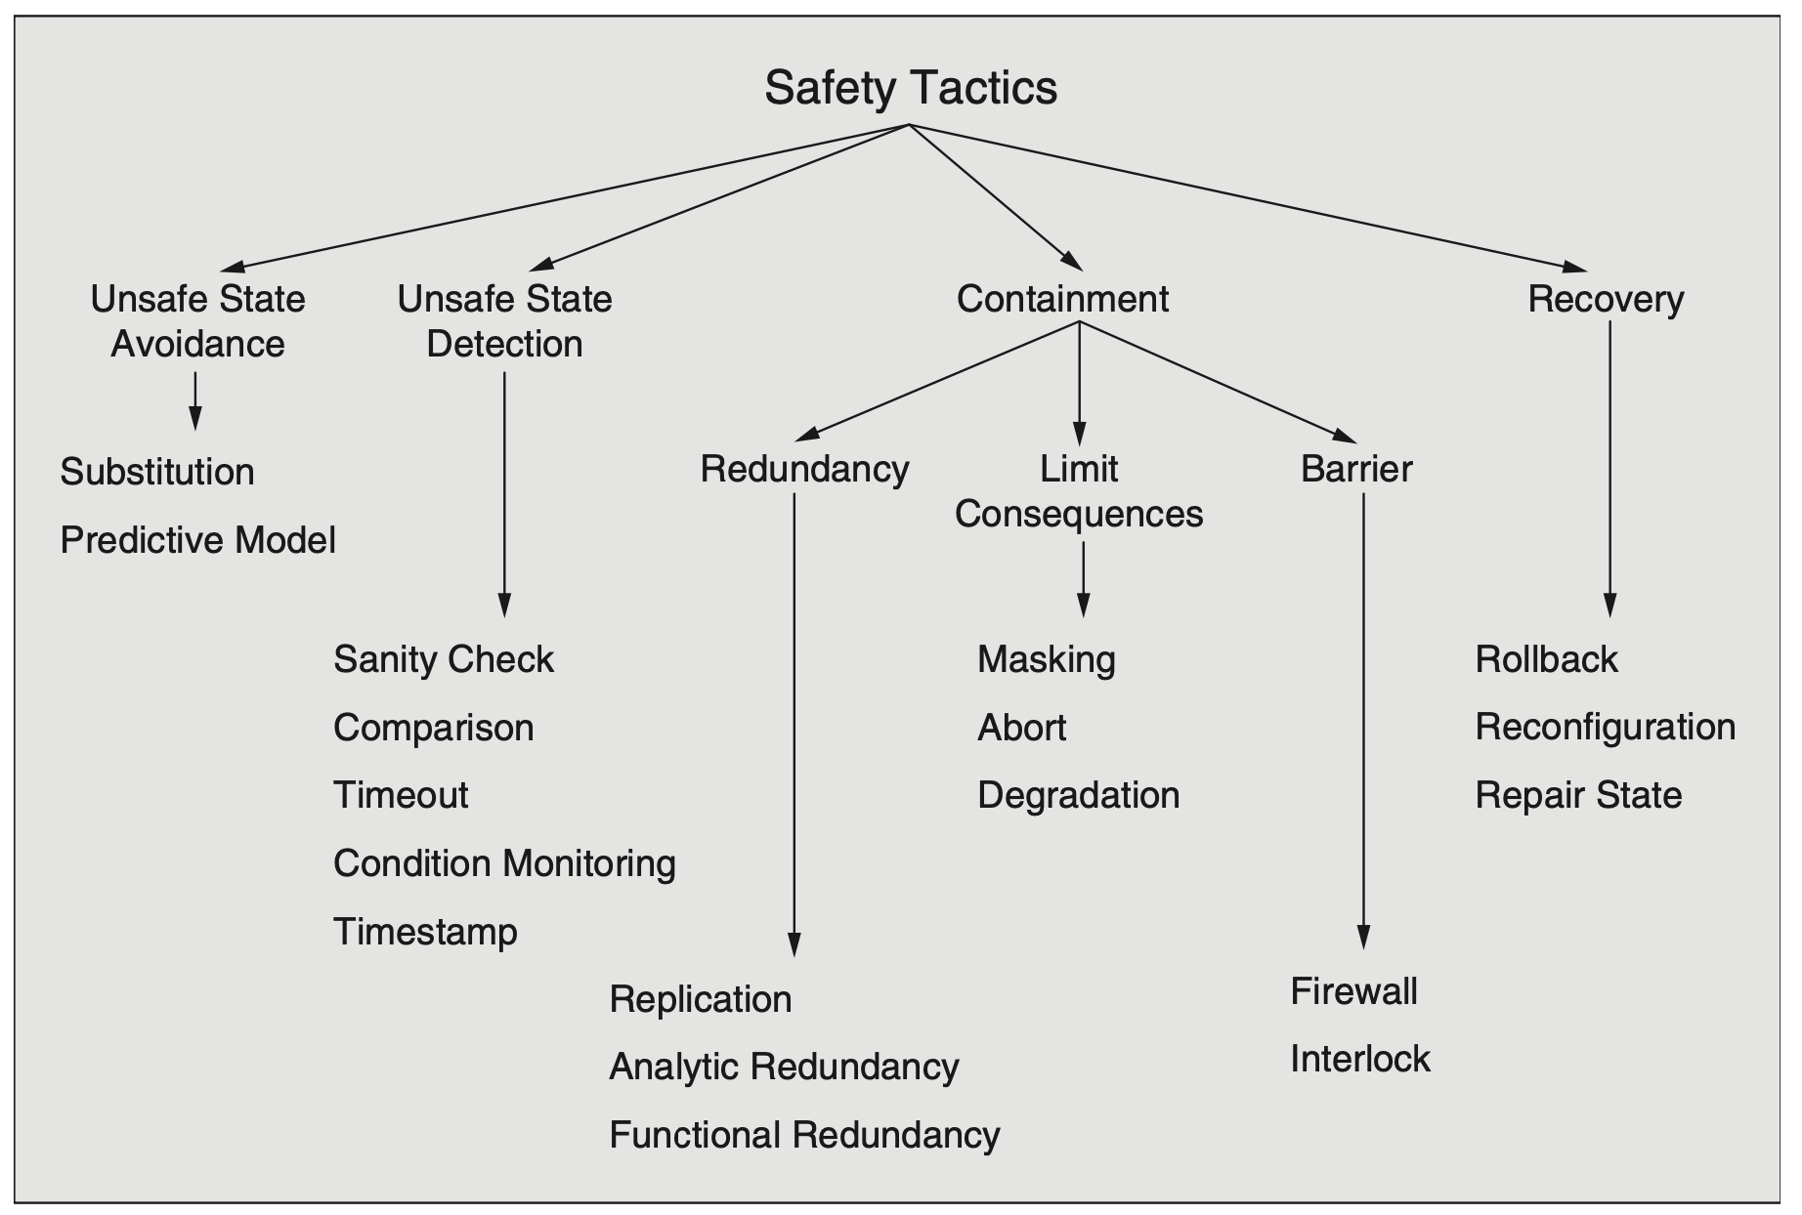
Safety Tactics

Slide 12
Unsafe State Avoidance
Substitution. This tactic employs protection mechanisms—often hardware-based—for potentially dangerous software features. For example, devices such as watchdogs, monitors, and interlocks can be used in lieu of software versions. Software versions of these mechanisms can be starved of resources, whereas a separate hardware device provides and controls its own resources.
Predictive Model. The predictive model tactic (introduced in Chapter 4), predicts the state of health of system processes/resources to provide early warning of potential problems.

Slide 13
Unsafe State Detection
Timeout. The timeout tactic is used to determine whether the operation of a component is meeting its timing constraints. This might be realized in the form of an exception being raised, to indicate the failure of a component if its timing constraints are not met.
Timestamp. As described in Chapter 4, the timestamp tactic is used to detect incorrect sequences of events, primarily in distributed message-passing systems. A timestamp can be established by assigning the state of a local clock to an event. Sequence numbers can also be used, since timestamps in a distributed system may be inconsistent across processors.
Condition Monitoring. This tactic involves checking conditions in a process or device, or validating assumptions made during the design, perhaps by using assertions. Condition monitoring identifies system states that may lead to hazardous behavior.

Slide 14
Unsafe State Detection
Sanity Checking. The sanity checking tactic checks the validity or reasonableness of specific operation results, or inputs or outputs of a component. This tactic is typically based on a knowledge of the internal design, the state of the system, or the nature of the information under scrutiny.
Comparison. The comparison tactic allows the system to detect unsafe states by comparing the outputs produced by a number of synchronized or replicated elements. Thus the comparison tactic works with a redundancy tactic. When the number of replicants is three or greater, the comparison tactic can not only detect an unsafe state but also indicate which component led to it.

Slide 15
Containment - Redundancy
Replication. Replication is the simplest redundancy tactic, as it just involves having clones of a com- ponent. Having multiple copies of identical components can be effective in protecting against random failures of hardware, but it cannot protect against design or implementation errors in hardware or software since there is no form of diversity embedded in this tactic.
Functional Redundancy. Functional redundancy is intended to address the issue of common-mode failures (where replicas exhibit the same fault at the same time because they share the same implementation), by having design diversity. The outputs of functionally redundant components should be the same given the same input.
Analytic Redundancy. Analytic redundancy involves partitioning the system into high assurance and high performance (low assurance) portions. The high assurance portion is designed to be simple and reliable, whereas the high performance portion is designed to be more complex and accurate, but less stable. If the high performance portion enters an unsafe state it can be replaced by the high assurance portion.

Slide 16
Containment – Limit Consequences
Abort. If an operation is determined to be unsafe, it is aborted before it can cause damage.
Degradation. The degradation tactic maintains the most critical system functions in the presence of component failures, dropping or replacing functionality in a controlled way. This approach allows individual component failures to gracefully reduce system functionality in a planned, deliberate, and safe way, rather than causing a complete system failure.
Masking. The masking tactic masks a fault by comparing the results of several redundant components and employing a voting procedure in case one or more of the components differ.

Slide 17
Containment – Barrier
Firewall. The firewall tactic is a specific realization of the limit access tactic, which is described in Chapter 11. A firewall limits access to specified resources, typically processors, memory, and network connections.
Interlock. The interlock tactic protects against failures arising from incorrect sequencing of events. Realizations of this tactic provide elaborate protection schemes by controlling all access to protected components, including controlling the correct sequencing of events affecting those components.

Slide 18
Recovery
Rollback. The rollback tactic permits the system to revert to a saved copy of a previous known good state upon the detection of a failure. This tactic is often combined with checkpointing and transactions, to ensure that the rollback is complete and consistent.
Repair State. The repair state tactic repairs an erroneous state—effectively increasing the set of states that a component can handle competently (i.e., without failure)—and then continues execution.
Reconfiguration. Reconfiguration attempts to recover from failures by remapping the logical architecture onto the resources left functioning. Ideally, this remapping allows full functionality to be maintained. When this is not possible, the system may be able to maintain partial functionality in combination with the degradation tactic.

Slide 19
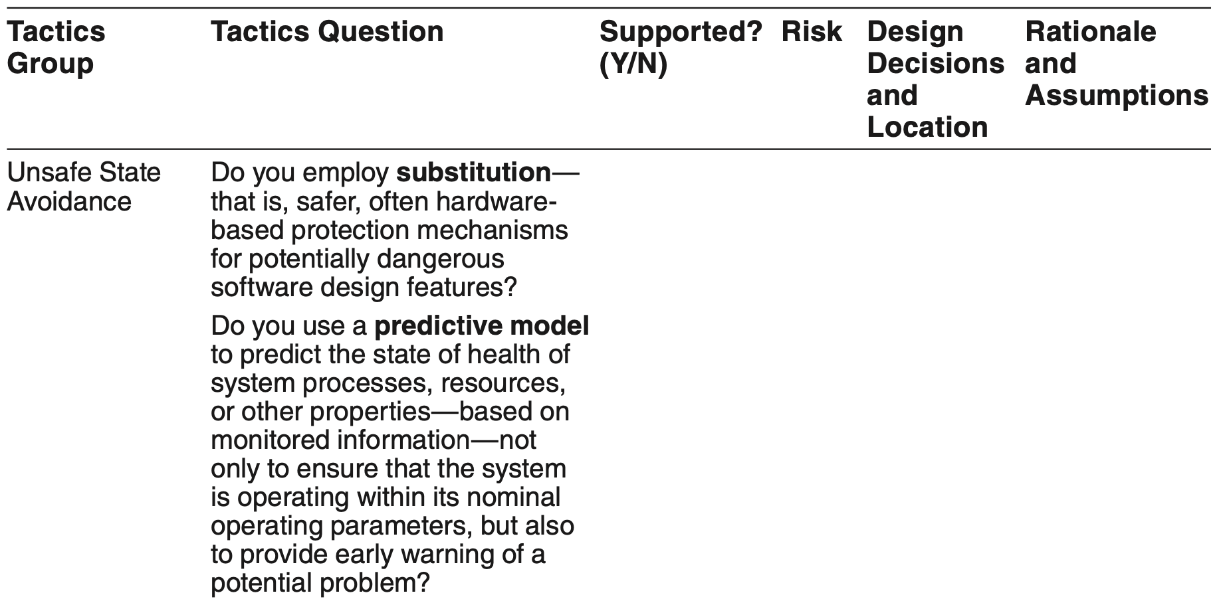
Tactics-Based Questionnaire for Safety

Slide 20
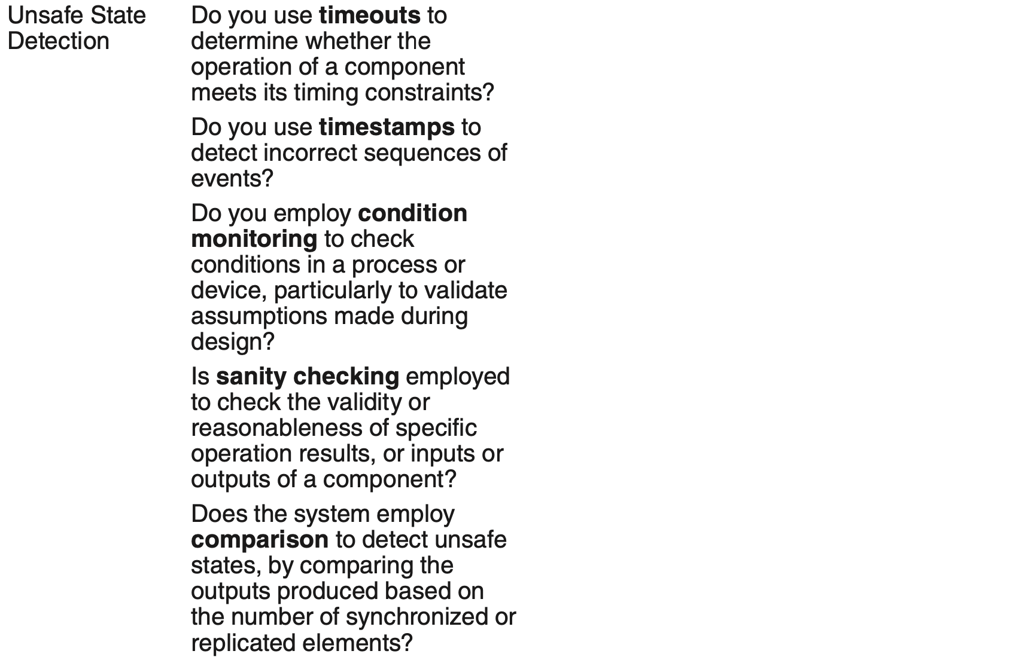
Tactics-Based Questionnaire for Safety

Slide 21
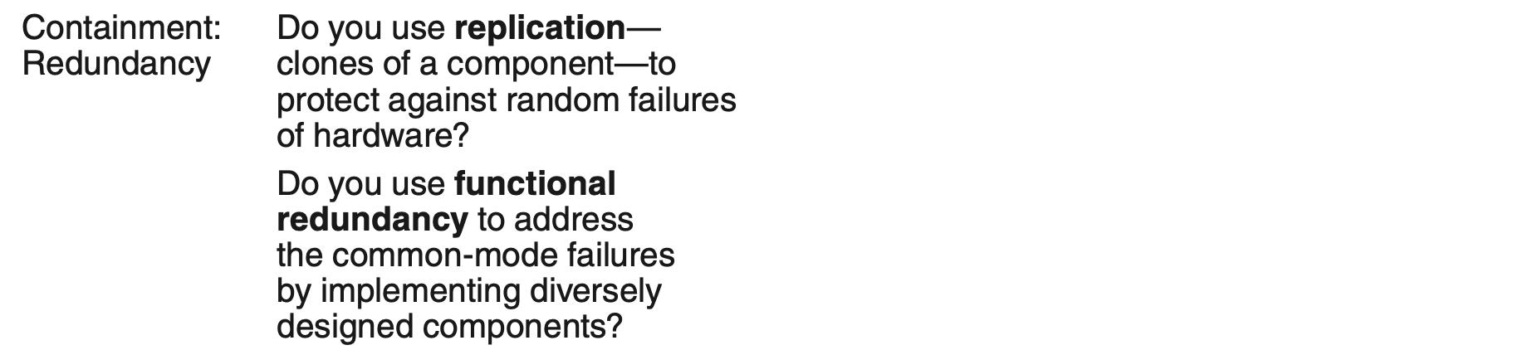
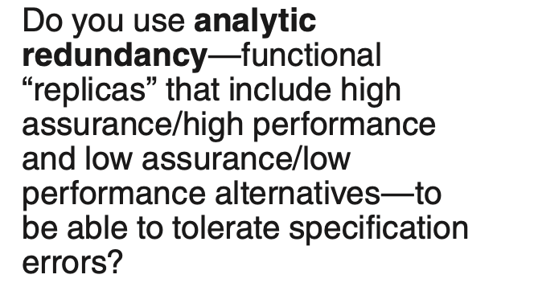
Tactics-Based Questionnaire for Safety

Slide 22
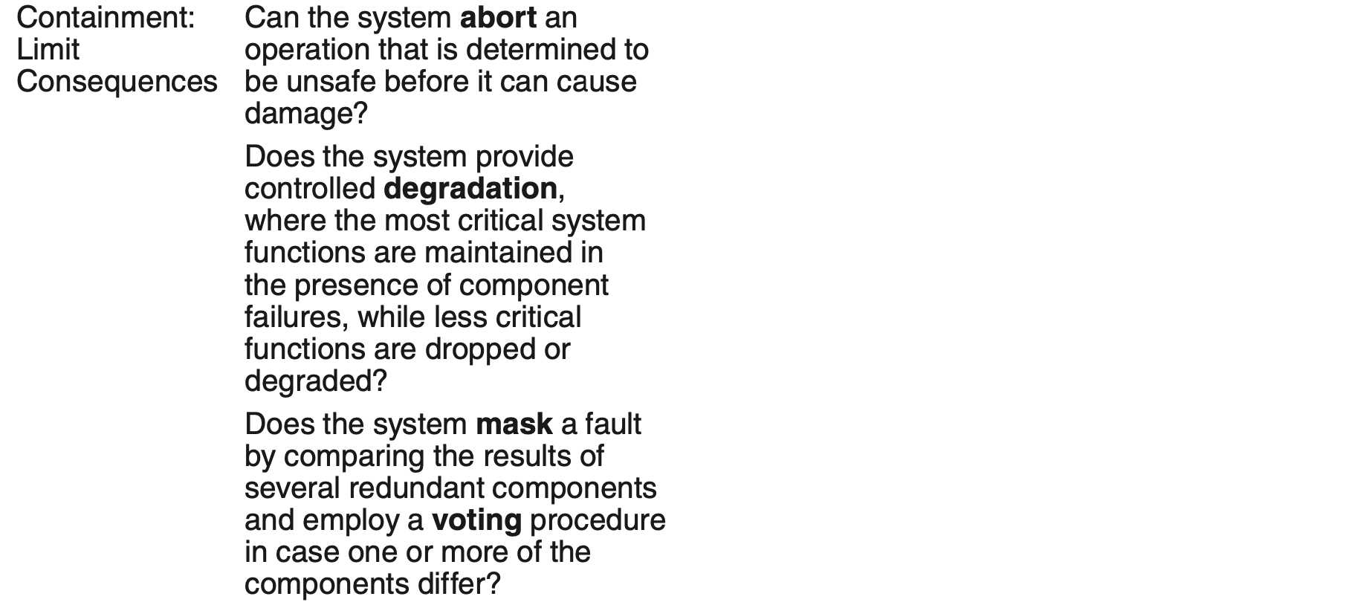
Tactics-Based Questionnaire for Safety

Slide 23
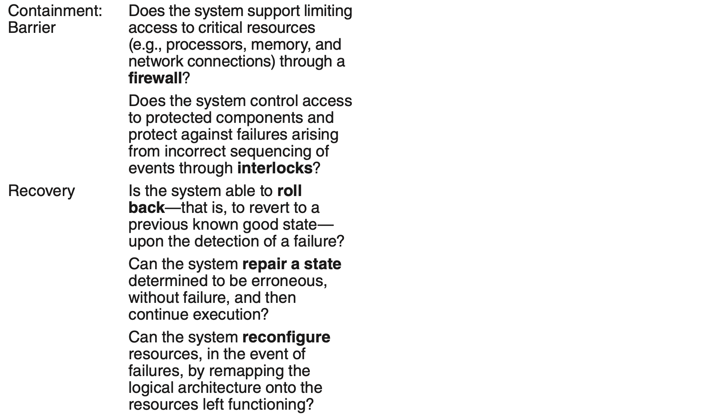
Tactics-Based Questionnaire for Safety

Slide 24
Redundant Sensors Pattern for Safety
If the data produced by a sensor is important to determine whether a state is safe or unsafe, that sensor should be replicated. This protects against the failure of any single sensor.
Also, independent software should monitor each sensor.

Slide 25
Redundant Sensors Pattern Benefits
Benefits:
This form of redundancy, which is applied to sensors, guards against the failure of a single sensor.

Slide 26
Redundant Sensors Pattern Tradeoffs
Tradeoffs:
Redundant sensors add cost to the system, and processing the inputs from multiple sensors is more complicated than processing the input from a single sensor.

Slide 27
Monitor-Actuator Pattern for Safety
This pattern focuses on two software elements—a monitor and an actuator controller—that are employed before sending a command to a physical actuator.
The actuator controller performs the calculations necessary to determine the values to send to the physical actuator.
The monitor checks these values for reasonableness before sending them.
This separates the computation of the value from the testing of the value.

Slide 28
Monitor-Actuator Pattern Benefits
In this form of redundancy applied to actuator control, the monitor acts as a redundant check on the actuator controller computations.

Slide 29
Monitor-Actuator Pattern Tradeoffs
The development and maintenance of the monitor take time and resources.
Because of the separation between actuator control and monitoring, this tradeoff is easy to manage by making the monitor as simple (easy to produce but may miss errors) or as sophisticated (more complex but catches more errors) as required.

Slide 30
Separated Safety Pattern for Safety
Safety-critical systems must frequently be certified as safe by some authority.
Certifying a large system is expensive, but dividing a system into safety-critical portions and non-safety-critical portions can reduce those costs. Only the safety-critical portion must be certified.
Likewise, the division into safety-critical and non-critical portions must be certified to ensure that there is no influence on the safety-critical portion from the non-safety-critical portion.

Slide 31
Separated Safety Pattern Benefits
The cost of certifying the system is reduced because you need to certify only a (usually small) portion of the total system.
Cost and safety benefits accrue because the effort focuses on just those portions of the system that are germane to safety.

Slide 32
Separated Safety Pattern Tradeoffs
The work involved in performing the separation can be expensive. However, this approach limits the risk and consequences of bugs in the non-safety-critical portion from affecting the safety-critical portion.
Separating the system and convincing the certification agency that the separation was performed correctly and that there are no influences from the non-safety-critical portion on the safety-critical portion is difficult, but is easier than the alternative: having the agency certify everything to the same rigid level.

Slide 33
Summary
Safety is about a system’s ability to avoid straying into states that lead to damage, injury, or loss of life.
Design for safety begins with identifying safety-critical functions using techniques like FMEA and FTA.
Designing for safety is challenging but there is a rich set of tactics and patterns to aid the designer.

